Slide 1
IoT Data Alchemist Hackaton
미세먼지를 피할수 있는 산책로 찾기 시스템
Find trails system for avoiding fine dust
TEAM NUGABAR
Notes:
Hi my name is Sung-ho Yun.
I’m in charge of the presentation of our team
From now on, i'll start the presenting on our topic
Our topic is to find trail systems for avoiding fine dust

Slide 2
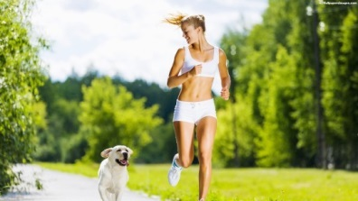
2017 창의적 종합설계 경진대회
Develop Motive
Walking Effect
Obesity, diabetes, depression, cancer risk falls
Creativity is enhanced by walking
Proper sunshine, better than a pill.
Dementia can be prevented.
Notes:
First I will explain the what our development motives.
Walking has a enormous positive effect on our bodies.
First It reduces the risk of obesity, diabetes, depression, and cancer.
According to the researchers, maintaining a habit of walking for 30 minutes every day will significantly reduce the risk of obesity, diabetes and depression.
Second is more creative.
Also, according to the research of Stanford University
People are more creative when walking than sitting
third help strengthen In the body's immune system and helps the wound heal quickly.
forth Walking provides energy to the brain, that helps prevent mental degeneration
This can help prevent dementia.

Slide 3
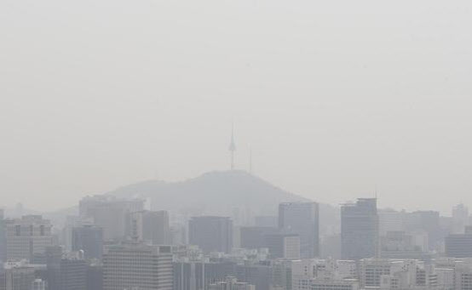
2017 창의적 종합설계 경진대회
개발 동기
direct cause of various respiratory diseases
Causes of atopic dermatitis
Increased risk of underweight and
stillbirth in newborns
Causes headaches.
World's second worst air quality
< Seoul fine dust situation >
Notes:
However, we can’t go out walking because korea’s air status is bad
so the Air Visual is the world's air pollution status monitoring Organization,
The Organization’s announcement is that Seoul's Air Quality Index (AQI) was 179 period this is the world’s second the worst air quality

Slide 4
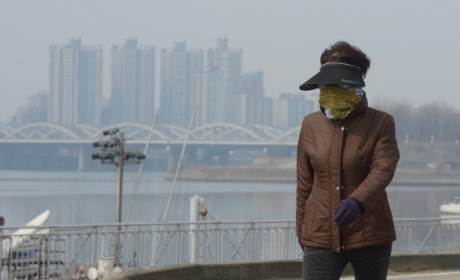
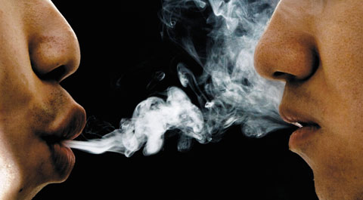


2017 창의적 종합설계 경진대회
개발 동기
< 60 minutes walking in fine dust >
< Secondhand smoke 84 minutes>
Notes:
If you walking in fine dust environment at 60 minutes that is negative effect equals secondhand smoke at 84 minutes

Slide 5
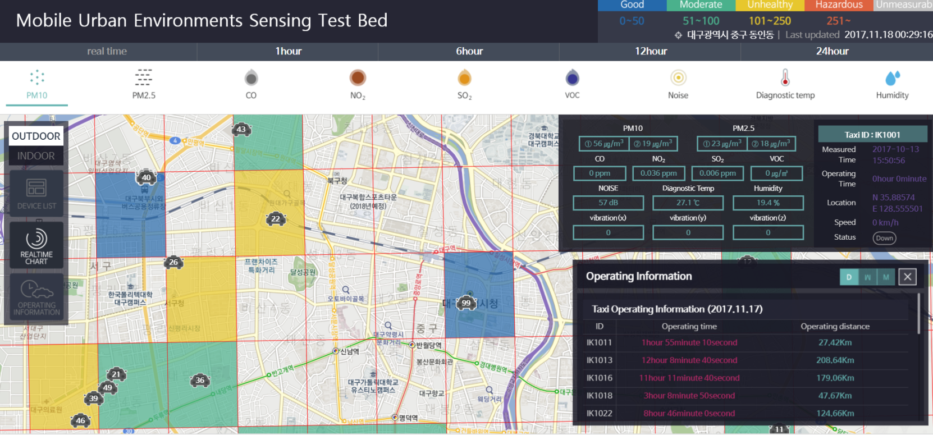
2017 창의적 종합설계 경진대회
개발 방법
<Mobile Urban Sensing Dataset>
Notes:
So we’ll ues Mobile Urban Sensing Dataset in Daegu
And use Mapping Algorithm system
We will provide the best trails.

Slide 6
THANK YOU
END

